Slide 1
Data Lakes and Cloud Data Warehousing
Yuanyuan Gao

Slide 2
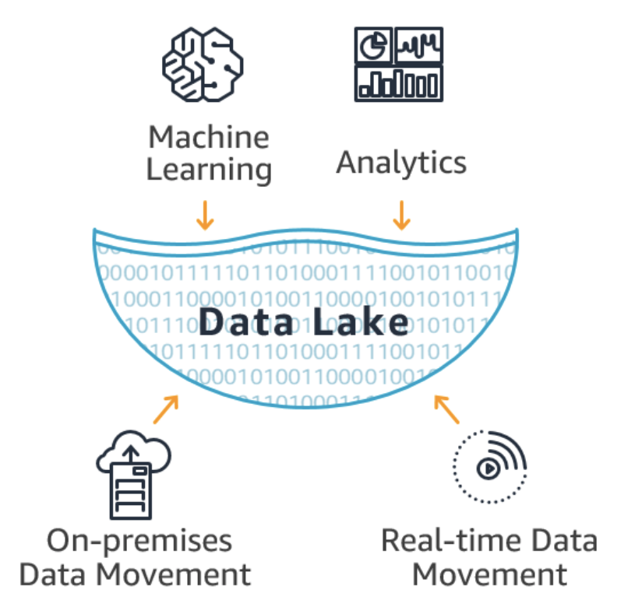
Data Lakes
A data lake allows you to store all your structured and unstructured data, in one centralized repository, and at any scale.
Store users’ data as-is, without having to first structure the data, based on potential questions you may have in the future;
Allow users to run different types of analytics on your data like SQL queries, big data analytics, full text search, real-time analytics, and machine learning to guide better decisions.

Slide 3
Data Lakes v.s. Data Warehouses
A data warehouse is a database optimized to analyze relational data coming from transactional systems and line of business applications.
The data structure, and schema are defined in advance to optimize for fast SQL queries;
Used for operational reporting and analysis;
A data lake stores relational data from line of business applications, and non-relational data from mobile apps, IoT devices, and social media.
The structure of the data or schema is not defined when data is captured;
SQL queries, big data analytics, full text search, real-time analytics, and machine learning

Slide 4
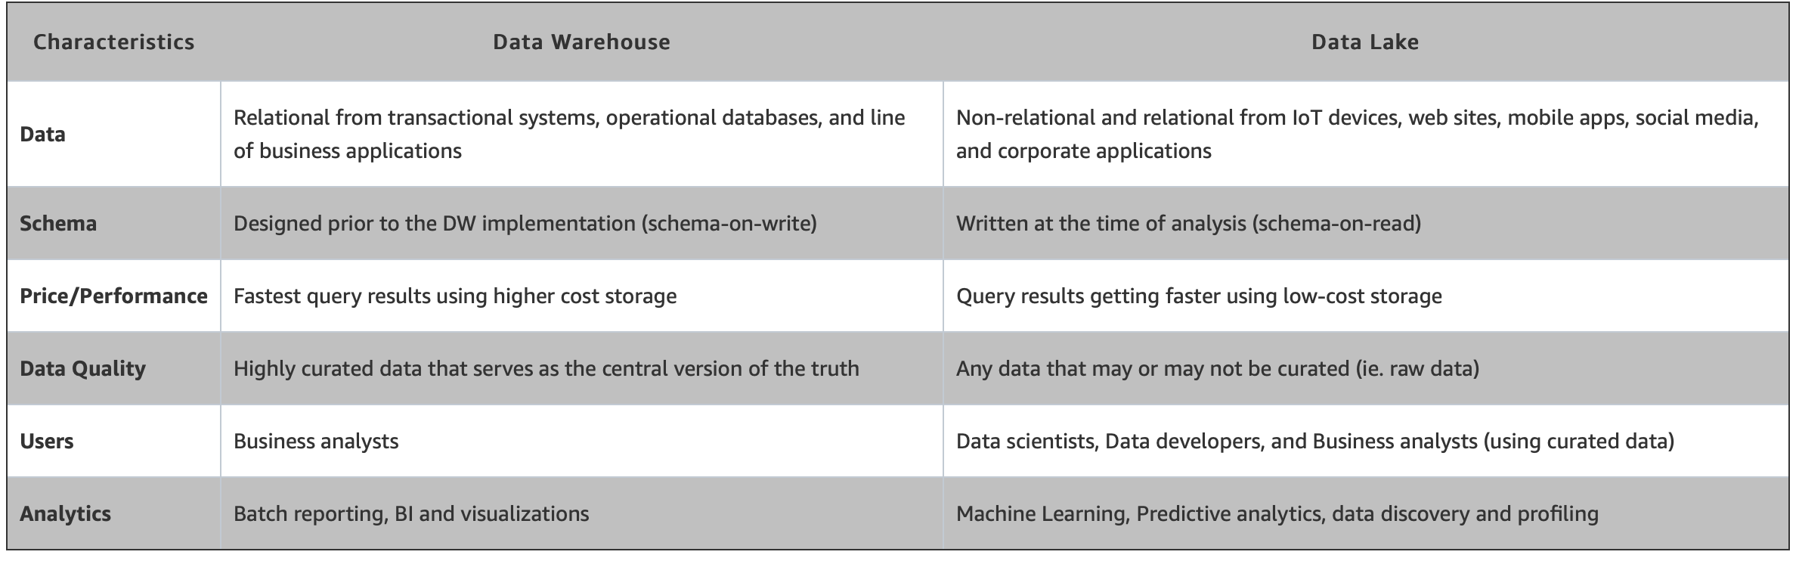
Data Lakes v.s. Data Warehouses

Slide 5
Essential elements of a Data Lake and Analytics solution
Data movement
Import any amount of data that can come in real-time.
Securely store, and catalog data
Store relational data like operational databases and data from line of business applications, and non-relational data like mobile apps, IoT devices, and social media.
Analytics
Data scientists, data developers, and business analysts to access data with their choice of analytic tools and frameworks.
Machine Learning
Generate different types of insights including reporting on historical data, and doing machine learning where models are built to forecast likely outcomes.

Slide 6
Enterprise DW Bus Architecture
Processes
Inbound inventory of products (toiletries, capital equipment) KPI – amount of inventory Purchasing – KPI – amount of purchases
Operations Bookings, - KPI- No of bookings, revenue
Outbound
Sales and Marketing
Service (concierge, room service etc.) – KPI – cust satisfaction, No of services
HR, Procurement, Accounting, Infrastructure – KPI – emp performance, costs
Booking (Customer, RoomType, Hotel, Channel (Web, phone, walkin), Date, Promotion,)
Service
Marketing
Procurement
CheckIn/Checkout
Facilities Management
Accounting
Notes:
Inbound – inventory of products (toiletries, capital equipment) – KPI – amount of inventory
Purchasing – KPI – amount of purchases
Operations – Bookings, - KPI- No of bookings, revenue
Service – (concierge, room service etc.) – KPI – cust satisfaction, No of services
HRM – KPI – emp performace, costs
Marketing – web, magazines etc. KPI – conversions – same for marketing and sales?
Booking (Customer, RoomType, Hotel, Chanel (Web, phone, walkin), Date, Promotion,)

Slide 7
Enterprise Data Sources
Business Process | Relational | Non-Relational
Booking | Reservations, Payments | Clickstream, Server logs
Service | Payments, Request logs | Sensor logs
Marketing | Marketing Campaign, Budgets | Website reviews, Social Media
Procurement
Check IN/ Check Out
Facilities Management |  | IoT, Sensors
Accounting

Slide 8
Data Storage Use Cases
NoSQL
Key value, graph, Document, IoT
Hadoop
Logs, Streaming, Web
RDBMS
Relational
Real-time analytics
High value / ACID compliant (ACID is a set of properties of database transactions intended to guarantee data validity despite errors, power failures, and other mishaps)

Slide 9
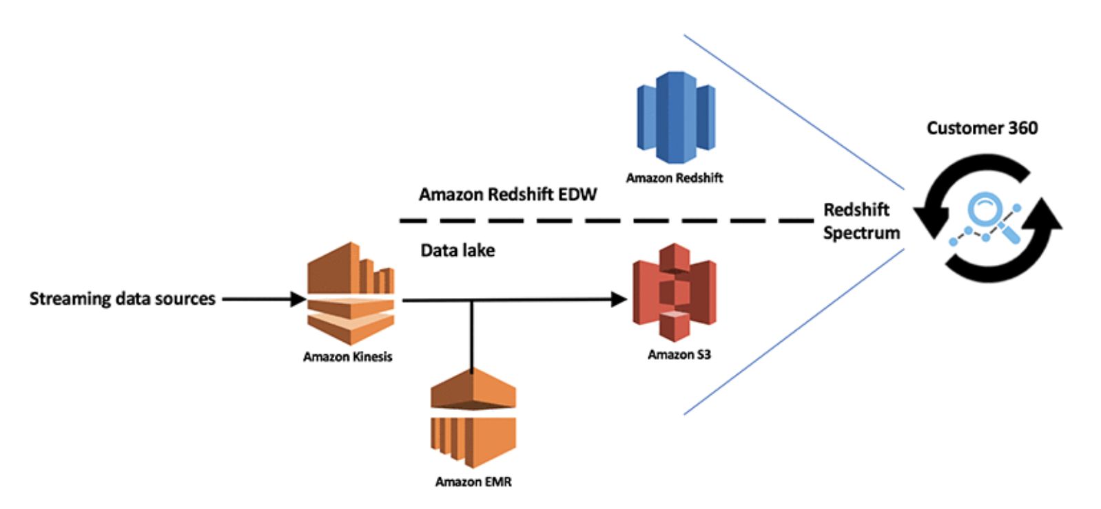
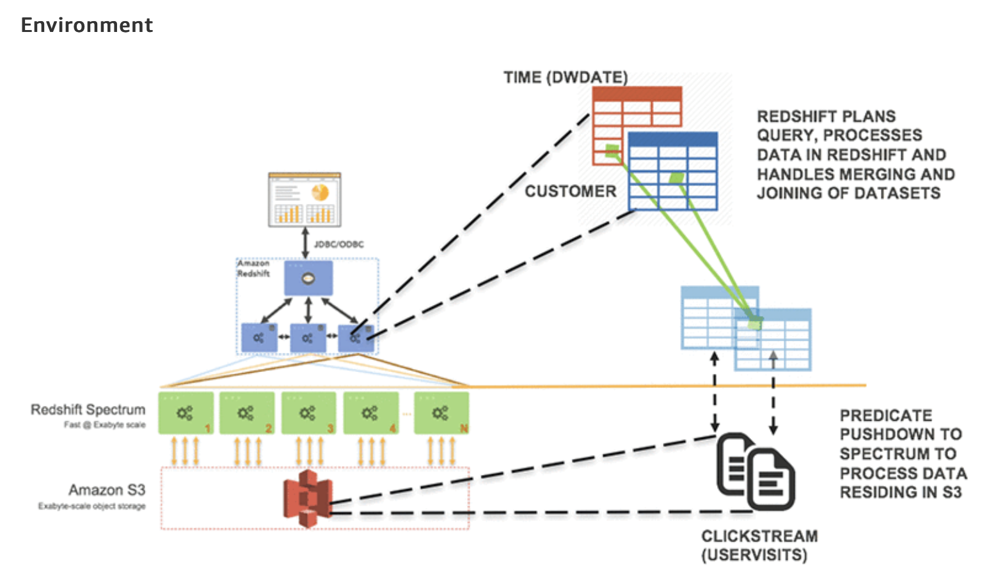
From Data Lake to Data Warehouse: Enhancing Customer 360 with Amazon Redshift Spectrum
Source: From Data Lake to Data Warehousing with Amazon Redshift

Slide 10
Case Study: Social Data Warehousing
Social Customer Relationship Management (CRM) is important!
Social CRM can drive:
Marketing Impact: driving specific messages to the channels where people live.
Channel Growth: identifying existing customer relationships who live in that channel.
Relationship Depth: touchpoints for increased retention and word of mouth.

Slide 11
Data Warehousing: Key to Social CRM
Technical Challenges:
Key Linking:
Customers don’t live by the identify in the Social World, even keys like email address aren’t common.
Data Capture:
Difficult to find what customers are doing from staggering amount of information generated from social channels;
Data Modeling:
Textual social interactions; too many to classify for actual use;

Slide 12
Levels of Social Data
Level 1: Company Social
Reviews, Likes, Community Registration
Level 2: Channel Usage
The channels (Facebook, Linedin, Twitter, etc.) that the customer use;
Level 3: Identify/Handle
The “name” of your customer in a particular channel;
Level 4: Interests, Topics and Sentiments
Content and sentiment about the company
Level 5: Influence
How big are the influence
Company Social
Channel Usage
Identify
Interests, Topics and Sentiments
Influence

Slide 13
Integrating Social Data into DW
Data Streams
Big Data / Hadoop
Analytics
ETL
Data Warehouse
Twitter
Facebook
Blogs
Storage
Processing
Sentiment
SN Metrics
Match Customer
Match Product
Social Metrics enhanced DM
Text Analytics
Match Promotion etc.
Email response etc.
ETL, which stands for extract, transform, and load, is the process data engineers use to extract data from different sources, transform the data into a usable and trusted resource, and load that data into the systems end-users can access and use downstream to solve business problems.

Slide 14
Cloud Data Warehousing
A Cloud Data Warehouse is a database that is delivered as a managed service in the public cloud and is optimized for analytics, scale, and usability.
Allow businesses to focus on running their businesses rather than managing a server room, and they enable business intelligence teams to deliver faster and better insights due to improved access, scalability, and performance.

Slide 15
Why Cloud Data Warehousing: Complexity v.s. Cost
Complexity
(deployment & operational)
Use a SAAS DW in the cloud
AWS Redshift, MSFT SQL DW, Snowflake, BigQuery, Athena (Presto), …
Low complexity
No capex, low opex
Roll-your-own-Cloud (RYOC)
Rent a cluster of cloud servers
Buy, install, & configure software (Spark, Hive, Vertica, Asterdata, Greenplum, …)
Medium to high complexity
Low capex
Medium opex
Roll-your-own (RYO)
Buy & install a cluster of servers
Buy, install, & configure software (Vertica, Asterdata, Greenplum, …)
High complexity
Medium capex and opex
High
RYO
Only 2 options 10 years ago!
RYOC
Buy an appliance
Teradata, Microsoft APS, Netezza
High capex, low opex
Low complexity
Gold standard for performance
Medium
Appliance
Low
CLOUD DW
Cost (capex + opex)
Low
Medium
High

Slide 16
Why Cloud Data Warehousing: Instant gratification
Hardware and Deployment
Physical delivery and setup of cluster
IT deploys complex parallel system
Time to Insights
Months
Appliance
Months due to high capex cost
Significant due diligence through multiple vendor POCs
Physical delivery and setup of goods
Weeks
RYO
RYOC
Minutes
CLOUD DW
Cost
Low
Medium
High

Slide 17
Why Cloud Data Warehousing: Scalability and the price of agility
Time to make an adjustment
Months
Appliance
Weeks
RYO
RYOC
Minutes
CLOUD DW
Cost of making an adjustment
Low
Medium
High

Slide 18


Unfortunately, no “free lunch”
Absolute Performance
High
Appliance
Cloud DW
RYOC
Medium
RYO
Low
Cost
Low
Medium
High

Slide 19
Why Cloud DW?
No CapEx and low OpEx
Go from conception to insight in hours
Rock bottom storage prices (Azure, AWS S3, GFS)
Data Security
Flexibility to scale up/down compute capacity
Simple upgrade process

Slide 20
Scalable DW Fundamentals
Two dominant architectures
Shared-disk/storage
Shared-nothing
Partitioned tables
Partitioned parallelism
Columnar data stores

Slide 21
Shared Disk/Storage
Commodity servers connected to each other and storage using commodity networking
DB is stored on “remote storage” (e.g. a SAN, S3, Azure Storage)
Node 1
Node 2
Node K
CPU
CPU
CPU
…
MEM
MEM
MEM
Storage Area Network

Slide 22
Shared-Nothing
Commodity servers connected via commodity networking
DB storage is ”strictly local” to each node
Design scales extremely well
Node 1
Node 2
Node K
CPU
CPU
…
CPU
MEM
MEM
MEM
Interconnection Network

Slide 23
Table Partitioning
Shared Nothing
Shared Storage
What?
Distribute rows of each table across multiple storage devices
Why?
Spread I/O load
Facilitates parallel query execution
How?
Hash, Round Robin, Range

Slide 24
Partitioned Parallelism
Used to parallelize the execution of relational operators (selects, joins, aggregates, …)
By both shared-storage and shared-nothing systems
Pipelining is used between operators to avoid unnecessary disk I/Os.

Slide 25
Columnar data stores
Parallel Processing data warehouses are typically columnar stores, which are the most adaptable and cost-effective for analytics.
Columnar databases store and process data in columns rather than rows, allowing aggregate queries, which are commonly used for reporting, to run much faster.

Slide 26
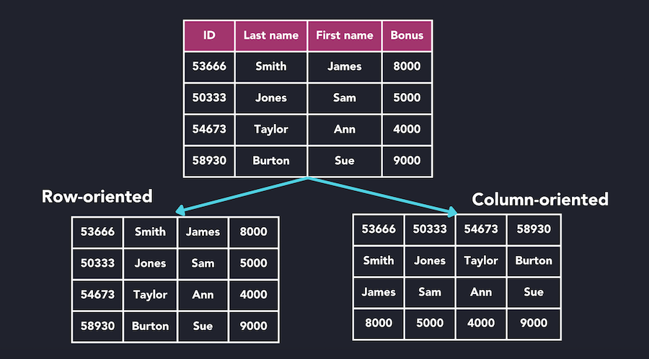
Columnar data stores

Slide 27
Cloud Data Warehouse (SaaS)
Azure
Cloud DW: SQL Data Warehouse
https://azure.microsoft.com/en-us/services/#analytics
AWS
Cloud DW: Redshift, Redshift Spectrum
https://aws.amazon.com/products/
Google Cloud
BigQuery
https://cloud.google.com/products/#data-analytics
Snowflake
Snowflake Data Cloud
https://www.snowflake.com/product/architecture/?utm_cta=website-workload-data-warehouse-architecture

Slide 28
Amazon (AWS) Redshift
Classic shared-nothing design w. locally attached storage
Leverages AWS services
EC2 compute instances
S3 storage system
Virtual Private Cloud (VPC)
Leader in market adoption

Slide 29
Redshift Summary
Highly successful cloud SAAS DW service
Classic shared-nothing design
Leverages S3 to handle node and disk failures
Key strength: performance through use of local storage
Key weaknesses: compute cannot be scaled independent of storage (and vice versa)
New “Redshift Spectrum” offering can query data in S3 w/o loading

Slide 30
Snowflake Elastic DW
Shared-storage design
Compute decoupled from storage
Highly elastic
Leverages AWS
Tables stored in S3 but dynamically cached on local storage Clusters of EC2 instances used to execute queries
Rich data model
Schema-less ingestion of JSON documents

Slide 31
Snowflake Summary
Designed for the cloud from conception
Can directly query unstructured data (JSON) w/o loading
Compute and storage independently scalable
AWS S3 for table storage
Virtual warehouses composed of clusters of AWS EC2 instances
Queries can be given exactly the compute resources they need
No management knobs
No indices, no create/update stats, no distribution keys, …

Slide 32
Google BigQuery
Separate storage and compute
Leverages Google’s internal storage & execution stacks
Colossus distributed file system
DremelX query executor
Jupiter networking stack
Borg resource allocator

Slide 33
BigQuery Tables
Stored in Colossus FS (Google’s file system)
Partitioned by day (optionally)
Columnar storage (Capacitor: BigQuery’s next-generation columnar storage format)
RLE compression
Sampling used to pick sort order
Columns partitioned across multiple disks
Also “external” tables
JSON, CSV, & Avro formats
Google Drive and Cloud Storage

Slide 34
CPU Resource Allocation
Compute resources not dedicated!
Shared among other internal and external customers
No apparent way to control computational resources used for a query
# of shards/slots assigned to an operator function of:
Estimated amount of data to be processed
Cluster capacity and current load

Slide 35
BigQuery Pricing
Storage: $0.02/GB/month
(AWS is about $0.023/GB/month)
Query options
1) Pay-as-you-go: $5/TB “processed”
- calculated after column is uncompressed
(AWS is about $1.60/TB using M4.4Xlarge EC2 instance)
2) Flat rate: $40,000/month for 2,000 dedicated slots

Slide 36
Pay For What You Use
Redshift
More storage requires buying more computation
No pause/resume mechanism
SQL DW
Charged separately for Azure storage and DWU usage
Snowflake
Charged separately for S3 storage and EC2 usage
BigQuery
Charged separately for GFS storage and TBs “processed”

Slide 37
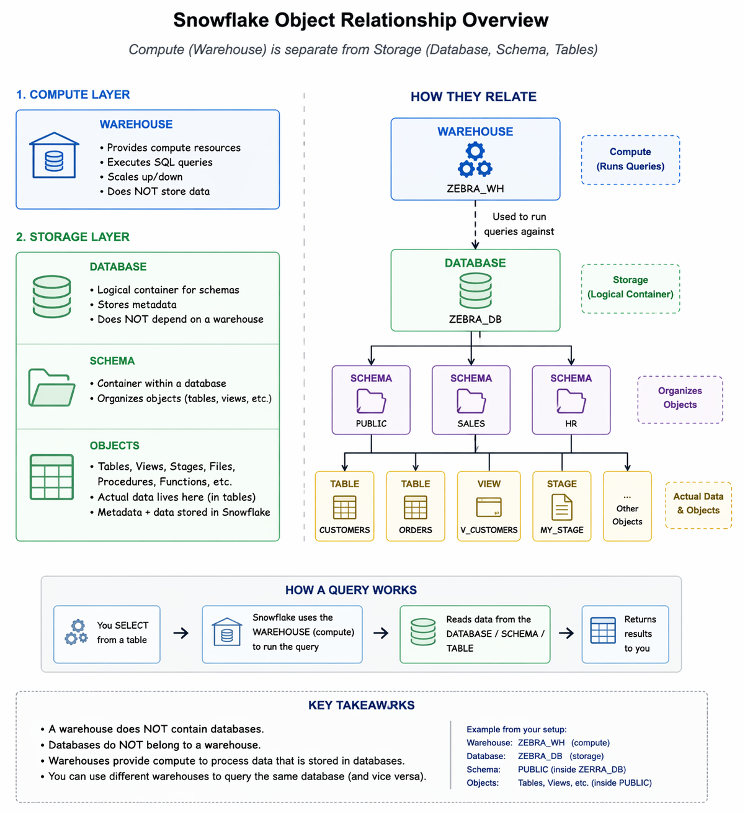
SnowFlake

Slide 38
AWS RedShift Exercise:
Distribution Styles
Even: Evenly distributed, use when no joins
Key: Based on Key column
All: Entire table, every node
Auto: All or Even based on table size
Distribution Style
Fact Table: Order; Distribution style: Even; Order rows distributed evenly across nodes. Joins require cross node computation
Fact Table: Order; Distribution style: Key (CustID); Customer and orders co-located, joins are on same node
“choose the foreign key for the largest frequently joined dimension as a distribution key”
Small Dimension Table: Use All (Why?)

Slide 39
AWS RedShift Exercise:
Sort Key Selection
Recent data (time column), frequently used column for filtering, join columns
Distribution Key Selection
Join columns, FK for largest frequently joined dimension
Primary and Foreign Key Constraints
Informational only, not enforced, used by query optimizer for efficient query plans
Column Size and Types
Small column sizes, use Date and Timestamp data types
More
Redshift Best Practices for Table Design
Table Tuning

Slide 40
Optimizing Queries (Redshift)
Optimize Table and Schema Design – Sort and Dist Keys
Avoid Select *
Avoid Cross Joins
Subqueries vs Joins
Calculate Cost - EXPLAIN
RedShift Designing Query Best Practices

Slide 41
Big Query and Data Warehousing
Google BigQuery Solution
Columnar Storage Data Warehousing Solution
Storage and Querying Costs
BigQuery for Data Warehousing
Optimized for JSON, Avro, etc. nested data structures
SCD is not straightforward
ETL and Staging requirements

Slide 42
BigQuery Controlling Costs
Avoid Select *
Partition Tables by date and use Where Partitiondate =
Use Query validator for number of bytes read
Materialize query results. (Row subsets)
More
https://cloud.google.com/bigquery/docs/best-practices-costs

